Slide 1
Privacy matters …
2024 – University Secretariat – Claire Milton
Notes:
Every public body is required to have a privacy or FOIPOP administrator. Under the Freedom of Information and Protection of Privacy Act, I now respond to access to information requests, maintain records relating to FOIPOP requests, and provide information to the university community about privacy. This presentation provides basic information about the law, and some best practices for people to follow to ensure we protect personal information.

Slide 2
Overview
Part 1: FOIPOP
Why does privacy matter?
What is personal information?
Overview of FOIPOP legislation
Part 2: Privacy: best practices
Information security and privacy breaches
Standard best practices
Part 3: Wrap up and Q&A
Notes:
Today’s workshop is divided into two sections:
The first section will provide a basic overview of FOIPOP. You will learn some of the basic rules and what your obligations are, as employees of Saint Mary’s University.
The second section will provide some tips and best practices on protecting privacy and personal information.
The workshop will close with a brief Q & A period

Slide 3
Why privacy matters
Saint Mary’s University is responsible for substantial amounts of personal information about students, faculty, staff, alumni, and donors. Protecting this information is a shared responsibility of all SMU employees.
We live in an age of information sharing. Unfortunately, this means that it is easy for people to become complacent about privacy and information security; however, we all have the right to expect that our personal information will remain safe and secure.
Protecting the privacy of personal information is required by law.
RESPONSIBILITY
TRUST
REPUTATION
LIABILITY

Slide 4
What is personal information?
3.1 (i) “Personal Information” means recorded information about an identifiable individual, including:
(v) the individual’s fingerprints, blood type or inheritable characteristics,
(vi) information about the individual’s health-care history, including a physical or mental disability,
(vii) information about the individual’s educational, financial, criminal or employment history,
(viii) anyone else’s opinions about the individual, and
(ix) the individual’s personal views or opinions, except if they are about someone else;
(i) the individual’s name, address or telephone number,
(ii) the individual’s race, national or ethnic origin, colour, or religious or political beliefs,
(iii) the individual’s age, sex, sexual orientation, marital status or family status,
(iv) an identifying number, symbol or other particular assigned to the individual,
Notes:
Personal Information is defined in the FOIPOP Act. It covers all recorded information in any form – i.e. print, digital, etc.

Slide 5
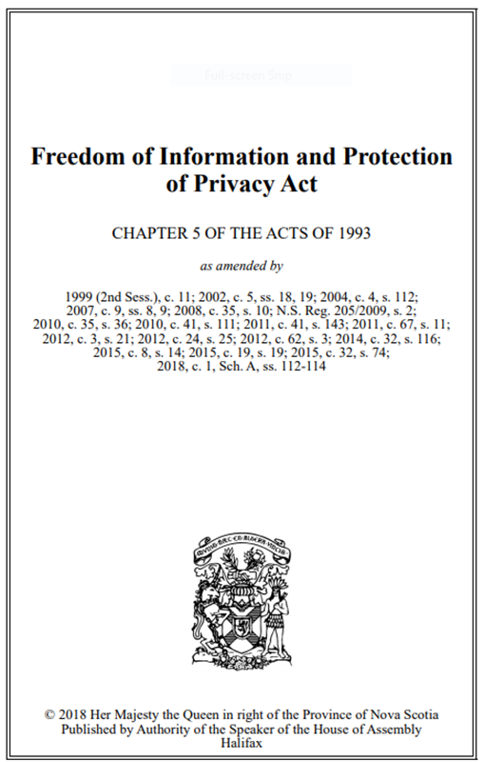
FOIPOP Act
All provinces and the federal government have laws to protect the privacy of personal information
All provinces and the federal government have laws to allow access to information held by public bodies
Legislation balances the right to access information against the right of individuals to personal privacy.

Slide 6
Information and privacy rights
Access: the right of access to records in the custody or under the control of a public body, including access to your own personal information; and
Privacy: the right of protection of privacy of your personal information in the custody or under the control of a public body.
Every employee of the University is required to protect the privacy of personal information.
Every employee is required to cooperate with the Privacy Officer with respect to access to information requests.

Slide 7
What is a record?
FOIPOP Act applies to all records in the custody or under the control of Saint Mary’s
A record is documented or fixed information – correspondence, video, emails, databases, or any other source of recorded or stored information.
Individuals have the right to request access to their personal information, to view this information, to ensure its accuracy, and to request correction of errors.
Notes:
If an employee does University work on a personal device or email – that record must be produced in response to an access to information request.
If the information requested does not exist as a record, the application cannot be granted. In support of transparency the FOIPOP process does allow for charging the applicant the cost of collating, assembling and copying the record.
Anyone and everyone has the right to request access to their own information – to view it, to ensure its accuracy and to request correction of errors.

Slide 8
Any person can apply to access information
ALL records in the custody or under the control of Saint Mary’s University are subject to the Act, and are “FOIPOP-able”
If an employee does work on a personal device, or uses personal email, that record must be produced in response to an access to information request
The university has the right to conduct a search for records in the event of a FOIPOP request
Notes:
The criteria that are used to decide if a record is in the custody or control of a public body or municipality go beyond the physical location of a record and involve factors such as the purpose of the record, who created it,
and whether or not it relates to the public body’s or municipality’s mandate or functions.
The University is introducing an email policy that will require the use of smu.ca email addresses for the conduct of university business

Slide 9
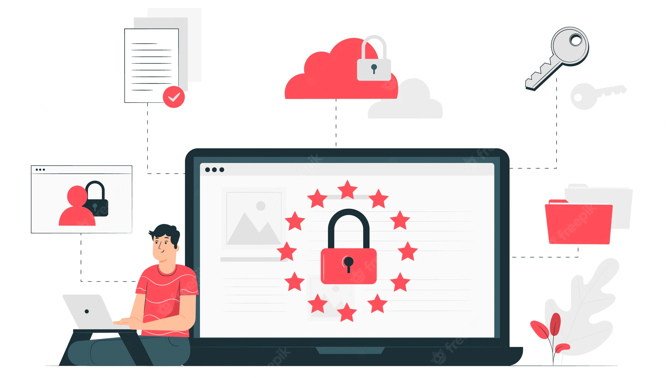
Privacy protection is everyone’s responsibility
Privacy rules apply to the collection, use, and disclosure of personal information
The University maintains records of personal information as a routine part of its operations
Every employee plays a role in ensuring we meet legal requirements

Slide 10
The balancing act
Duty to assist | Duty to protect
“Pursuant to the Act, all public bodies, municipalities and local public bodies are obliged to adopt a policy of accountability, openness and transparency and to provide a right of access to information with limited exceptions. They are also obliged to ensure the protection of individuals' personal privacy.” - NS Office of the Information and Privacy Commissioner | The Act is intended to support a balanced approach of access to information while, at the same time, ensuring the protection of personal information and thereby respecting an individual's right to privacy.
Notes:
When we respond to an access to information request we have a “duty to assist” the applicant.
The law says we must make every reasonable effort to assist the applicant by:
Responding without delay
Openly
Accurately
Completely
-respond promptly
-help applicants identify responsive records
-tell applicants about everything that is available
-give applicants a complete response
However, if a request is for records that include personal information of individuals other than the person seeking access, we may have to refuse access to that personal information.

Slide 11
Basics of privacy protection
No collection unless authorized
No use unless authorized
No disclosure unless authorized
Keep personal information secure
A public body cannot collect, use or disclose personal information unless specifically authorized under Nova Scotia’s privacy laws.
For example, personal information may only be collected in these circumstances:
When expressly authorized by law
For law enforcement
Because it is directly related to and necessary for an operating program or activity
Notes:
We must make reasonable security arrangements against such risks as unauthorized access, collection, use, disclosure or disposal of personal information.

Slide 12
Part 2
Privacy best practices

Slide 13
What is a privacy breach?
A privacy breach occurs when personal information is collected, retained, used or disclosed in ways that are not in accordance with the provisions of the Act.
Common examples of unauthorized disclosure of personal information:
sending communications to the wrong recipient (email, FAX)
improper records destruction procedures
loss or theft of unsecured devices, such as laptop computers, smart phones, digital cameras, or portable storage devices (USB sticks)
unauthorized access (snooping, looking up your co-worker’s birthday)
Unauthorized sharing (providing personal information to a person without an authorized “need to know”)

Slide 14
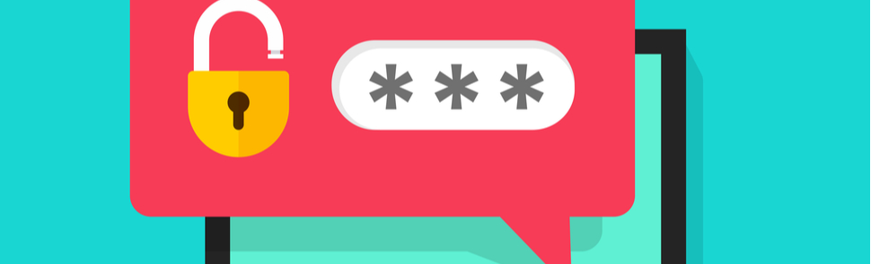
Best practices
Limit access to those who “need to know” to fulfil job responsibilities
Password protect sensitive records
Comply with password best practices
Do not share passwords
Follow EIT policies and guidance on passwords

Slide 15
Best practices: technology
Update your operating system when prompted
Complete cyber security training: report suspicious emails
Double check email addresses of your intended recipients BEFORE sending
Make it easier for people to identify you by including a profile photo or a department icon for your email account
Notes:
Make comments about what to do if there is a breach. Refer to form on website: Privacy Breach Report. Mention the requirement to notify the person affected in some cases.

Slide 16
Best practices: mobile devices and working from home
Mobile devices:
Password protection
Two step authentication
Avoid using USB drives
Working at home:
Use SharePoint and Teams
Use MFA
Minimize paper records
Secure your devices (i.e. NEVER leave in your car)
Report lost or stolen devices
Work in a confidential space

Slide 17
Best practices: on campus
Clean desk
Lock cabinets
Shut down computer if you are leaving it behind
Shred confidential paper
Use privacy screens on monitors
Use Teams, not email, to share and transmit sensitive files and information

Slide 18
Last word: recording
Policy 2-2004 – Policy on Information Technology
4.2 Users of university IT resources shall use University IT resources for the academic and administrative purposes for which they are intended - Limit personal use of University IT to modest, infrequent purposes. University IT facilities should be used primarily for university related educational and administrative purposes.
Policy 2-2006 – Email Policy
6.2 In general, email is not appropriate for transmitting sensitive or confidential information, including personal information, unless an appropriate level of security matches its use for such purposes.
Know when and when not to record meetings or conversations
Do not record anything without permission and consent
Recording in secret endangers personal privacy rights
Unauthorized recording of work conversations may breach confidentiality of protected and sensitive information
When using the university’s EIT systems (email, Teams, etc), your expectation of personal privacy is limited

Slide 19
Privacy and information security resources
Information security: https://www.smu.ca/academics/eit-information-security.html
Security awareness education: https://www.smu.ca/academics/eit-security-awareness-education.html
Cyber security while working off campus: https://www.smu.ca/covidinfo/cybersecurity.html
Privacy: https://www.smu.ca/privacy/index.html

Slide 20
Questions
Claire.Milton@smu.ca
privacy@smu.ca

